Slide 1


Team 54: ECEN215 Lab Kit 2
Bi-Weekly Update 4 Gavin Bernard
Maylun Huang
Evan Slyter
Sponsor: John Lusher TA: Hailey Ward
Notes:
Michelle

Slide 2
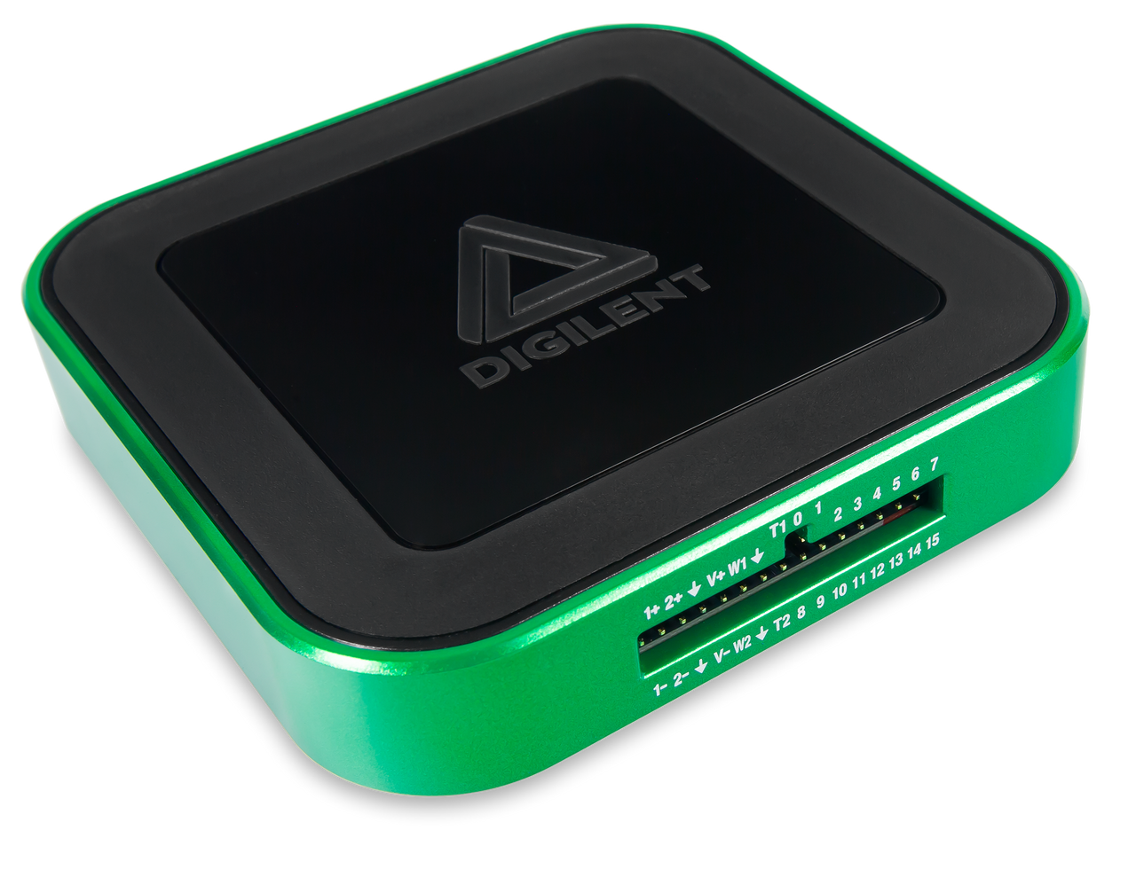
Project Summary
Problem statement:
Access to an affordable, course-specific solution for distance-learning students to complete ECEN215 Labs is minimal.
Our Solution:
An affordable, self-contained system that enables hands-on measurements and intuitive data displays.
Complete production of labkit for $50-$75
Easily transportable by hand.
AD3: $379
Notes:
Kyle

Slide 3

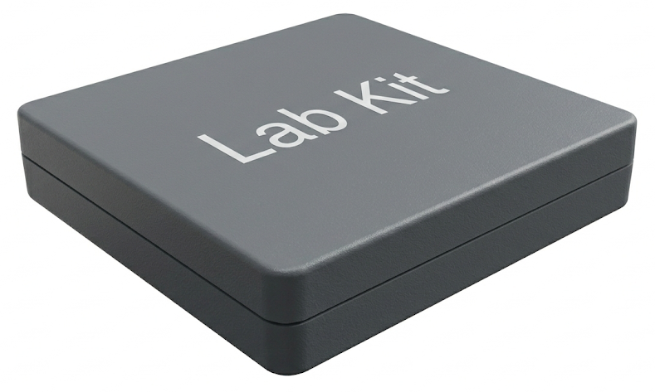
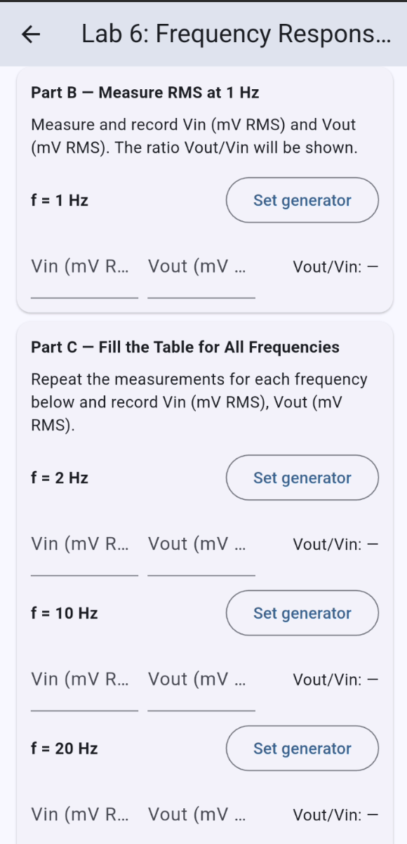
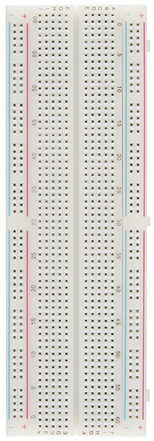
Integrated System Diagram
BLE
BLE
Lab Kit System
User’s Breadboard
Notes:
Eric

Slide 4
Project Timeline
2/9 | 2/23 | 3/16 | 3/23 | 3/30 | 4/20
Finalize PCB & order Phone-MCU BLE Validation | Soldered backup PCB Begin App Integration | Integrate Signal Gen-App Solder big PCB Integrate Measurement-App | Integration Complete Fully Coded | Final Validation | Final Demo
Notes:
Eric

Slide 5
Power Supply/Signal Generator Gavin Bernard
Accomplishments since last update 25 hrs of effort | Ongoing progress/problems and plans until the next presentation
Fully integrated DC power supply with App and Signal Generator Designed, Soldered, Tested Power Supply on backup PCB | Integrate Signal Generator on backup PCB with App Solder Power Supply and Signal Generator on complete PCB

Slide 6
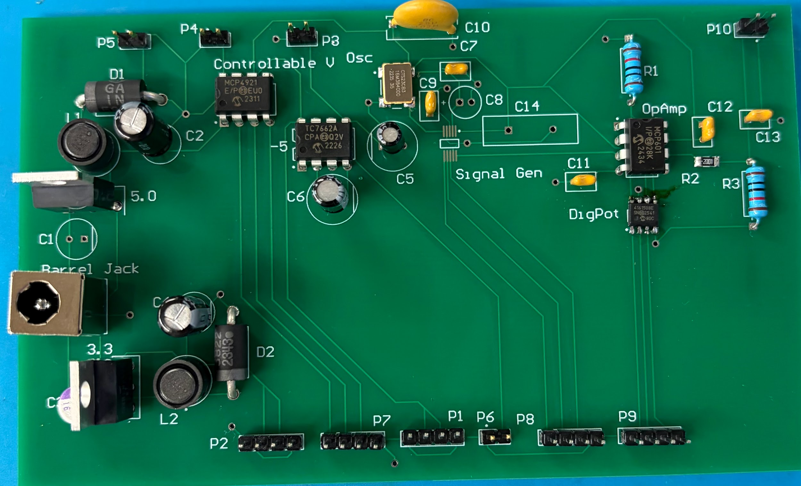
Power Supply/Signal Generator Gavin Bernard

Slide 7
Power Supply Gavin Bernard
3.3 Volt Buck Converter Testing
Resistor [Ω | Current [mA] | Output Voltage [V] | Power [mW]
30 | 109.33 | 3.28 | 359
20 | 164 | 3.28 | 538
10 | 328 | 3.28 | 1076
5 | 654 | 3.27 | 2,139
5.0 Volt Buck Converter Testing
Resistor [Ω | Current [mA] | Output Voltage [V] | Power [mW]
30 | 166 | 4.97 | 823
20 | 248 | 4.96 | 1,230
10 | 494 | 4.94 | 2,440
5 | 980 | 4.9 | 4,802

Slide 8
Power Supply Gavin Bernard
-5.0 Volt Charge-Pump Inverter Testing
Resistor [Ω | Current [mA] | Output Voltage [V] | Power [mW]
1,000 | 4.68 | -4.68 | 21.9
500 | 8.82 | -4.41 | 38.9
250 | 16.76 | -4.19 | 70.22
125 | 31.68 | -3.96 | 125.45
Variable Voltage Range using App
Input Voltage | Measured Output Voltage [V]
0.1 | 0.1
1 | 0.99
2 | 1.99
3.3 | 3.28
5 | 4.98

Slide 9
Signal Generator Gavin Bernard
Signal Generator using Arduino IDE
Input | Measured Waveform | Frequency [Hz]
Sine, 1,000 Hz | Sine | 900 Hz
Triangle, 500 Hz | Triangle | 450 Hz
Square, 300 Hz | Square | 280 Hz

Slide 10
Measurement Subsystem Maylun Huang
Accomplishments since last update 12 hrs of effort | Ongoing progress/problems and plans until the next presentation
Tested code for multimeter inputs, adjusting for internal resistances | On-going soldering parts onto combined PCB On-going mobile app code for multimeter selection

Slide 11
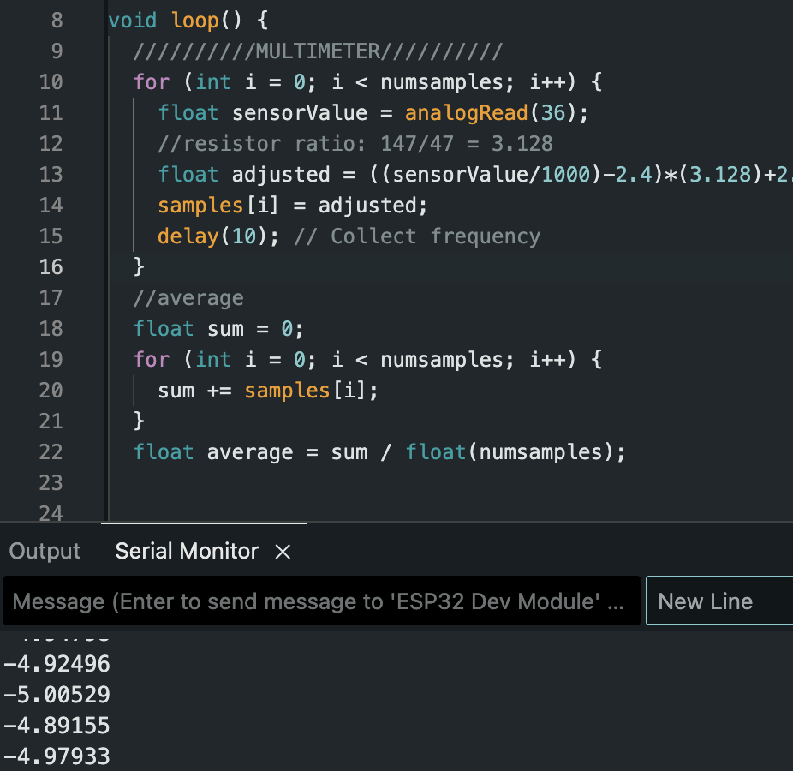
Measurement Subsystem Maylun Huang
Voltmeter
Raw Input | Expected | Actual
0.1 | -5 | ~-4.95
1.63 | 0 | ~-0.07
3.23 | 5 | ~4.94

Slide 12
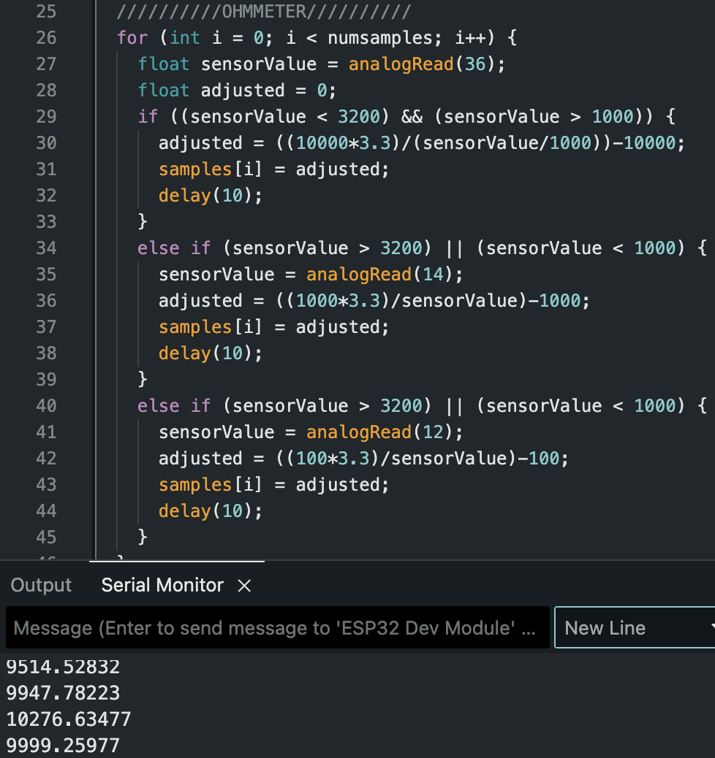
Measurement Subsystem Maylun Huang
Ohmmeter
Raw Input | Expected | Actual
3 | 1000 | 1000
2.2 | 5000 | 4950
1.65 | 10000 | 9900

Slide 13
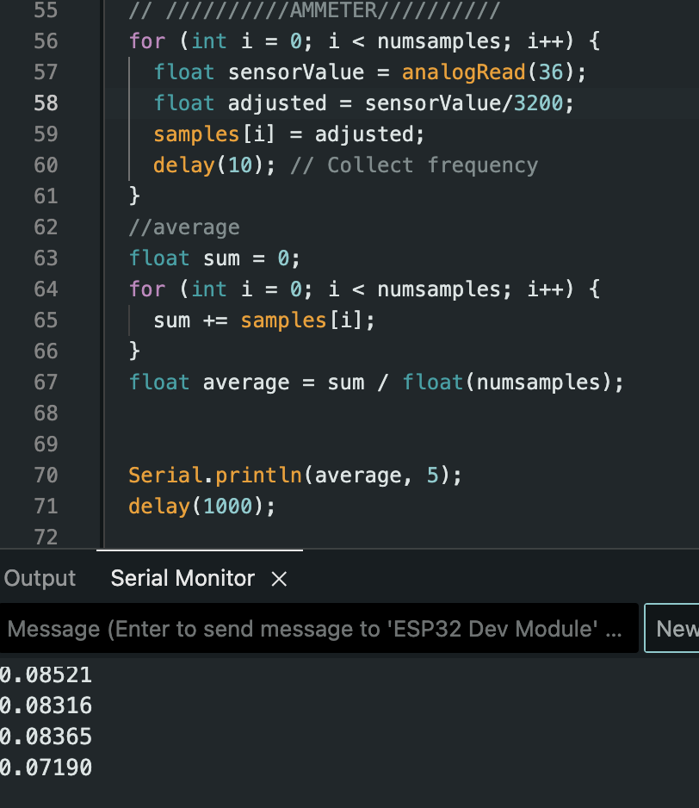
Measurement Subsystem Maylun Huang
Ammeter
Raw Input | Expected | Actual
0.32 | 0.1 | 0.083
1.6 | 0.5 | 0.487
3.2 | 1 | 1.01

Slide 14
Mobile App Evan Slyter
Accomplishments since last update 8 hrs of effort | Ongoing progress/problems and plans until the next presentation
-Power supply fully integrated with app. -Edited lab manual for lab 8. -Verified all commands come across bluetooth successfully. | -Continue integrating subsystems once they’re ready -Commands occasionally not executing on power supply.

Slide 15
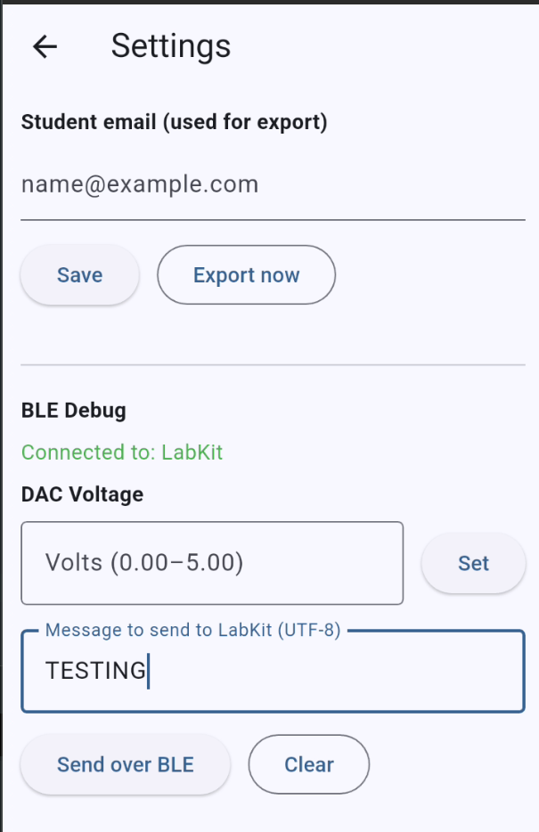
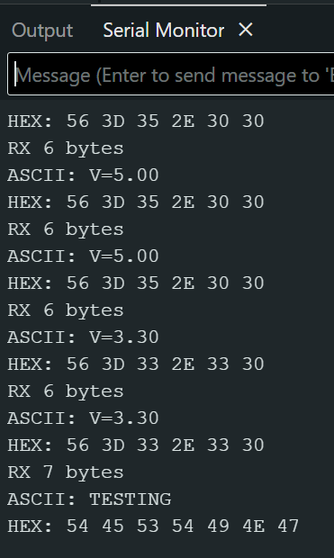
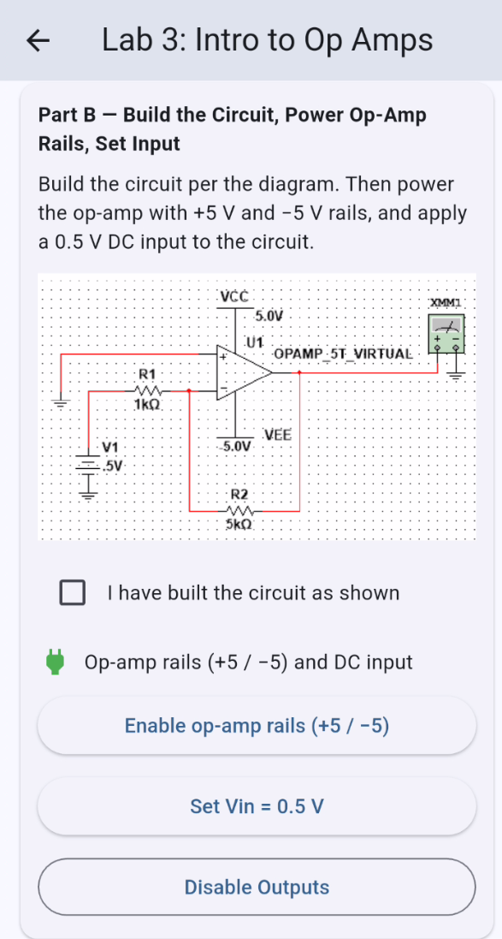
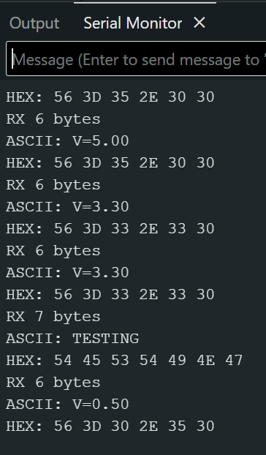
Mobile App Evan Slyter
Commands sometimes not registering
Doesn't seem time based
Hopefully Dev Board issue

Slide 16
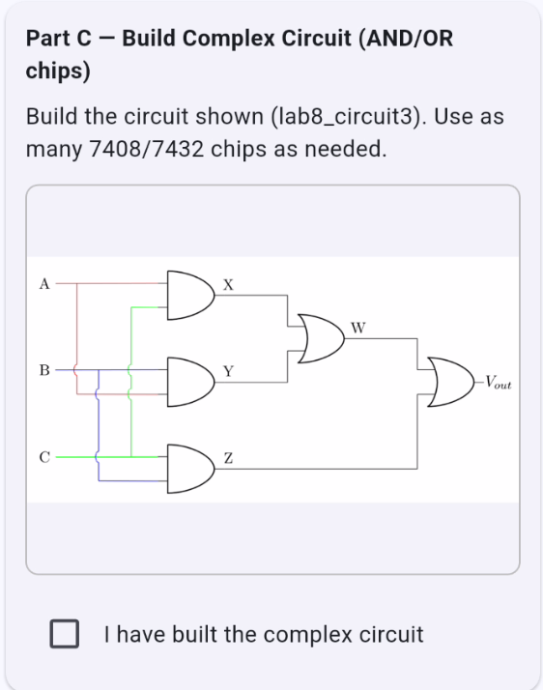
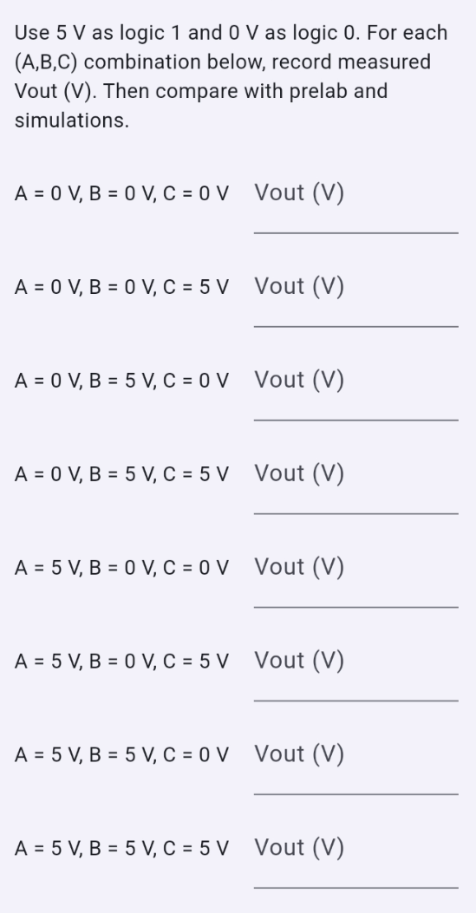
Mobile App Evan Slyter
Lab 8, AND/OR chips need 3 inputs.
Had to add section for voltage dividing.

Slide 17
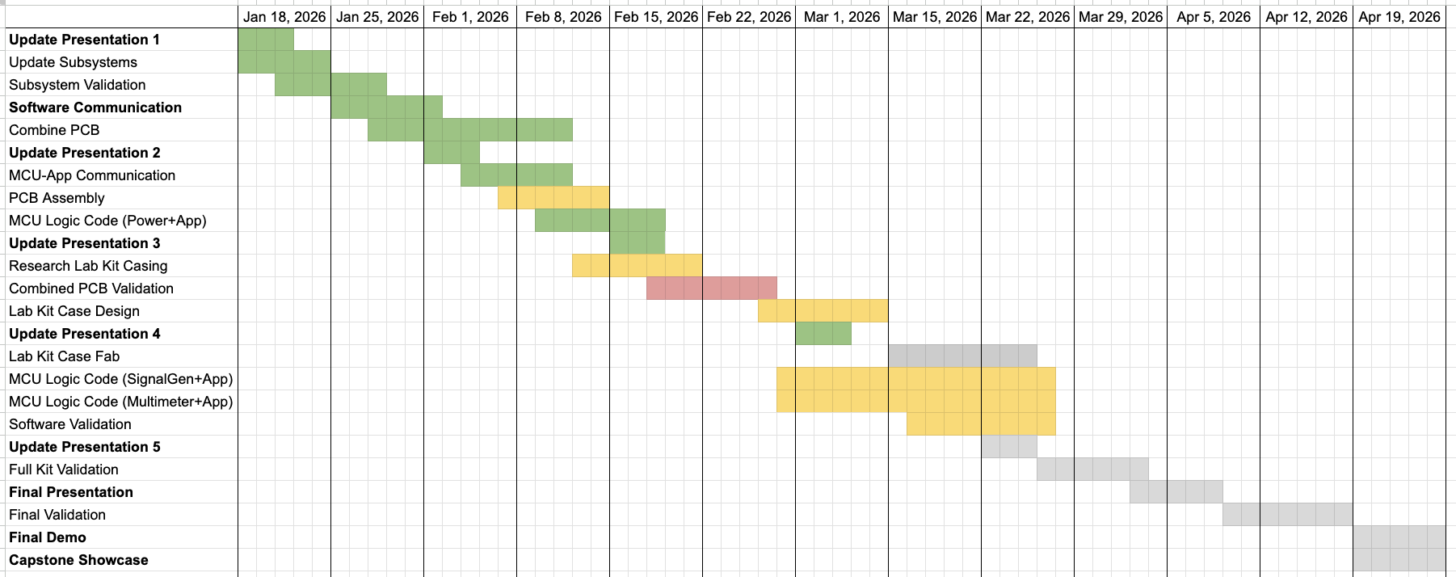
Execution Plan
Notes:
Michelle

Slide 18
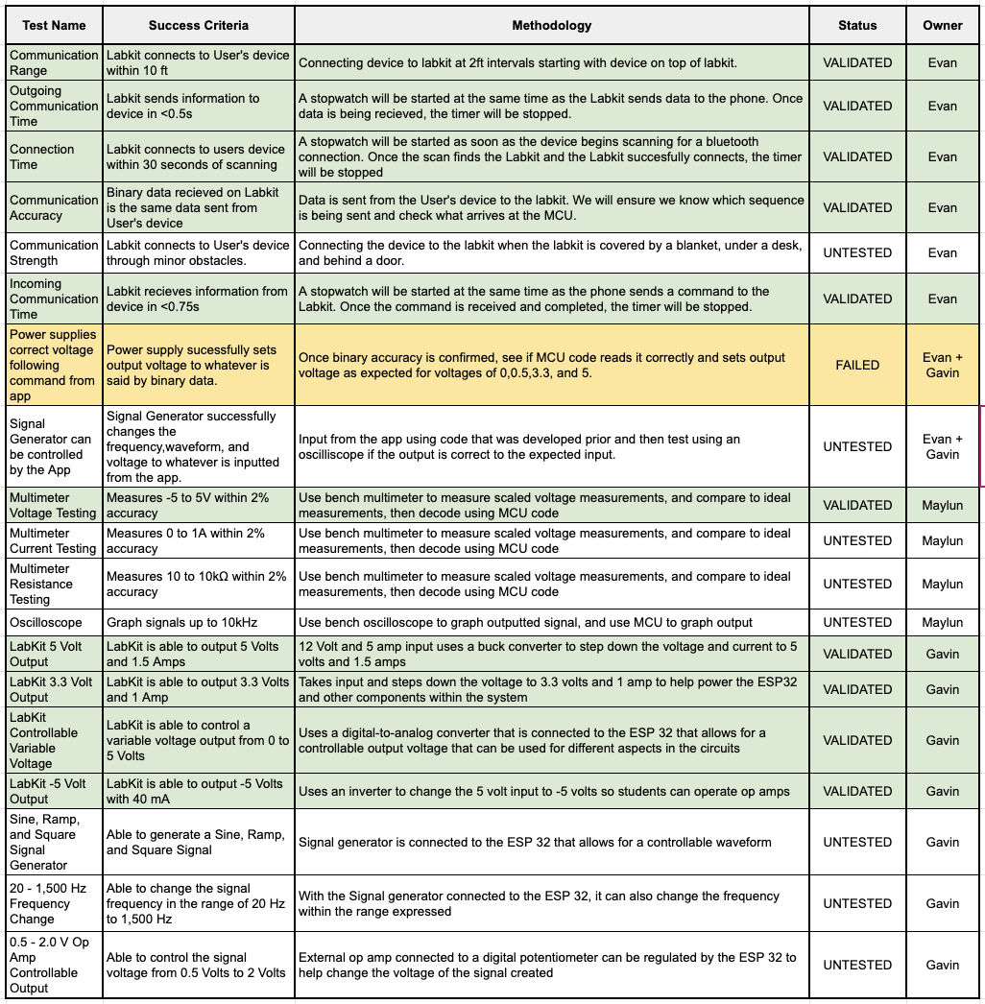
System Validation Plan
Notes:
Michelle

Slide 19
Questions?

